Slide 1

Capstone Project
Data Architecture
Reorder Cadence & Customer Engagement
Team 11
Anayev Adil - aa3258
Ziyi Li - zl2399
Renisha Rana - rr853
Elena Sistermann – eks97
Aniruthan Sivakumar – as4647

Slide 2
Recommendation
Personalized reminders should target customers whose order gap exceeds their expected cadence
Current problem
Recommendation
1
Customers order at different frequencies
1. Segment customers
A 14-day gap may be unusual for a weekly customer but normal for a monthly customer.
By historical ordering frequency and basket size
2
A single inactivity threshold can misclassify engagement
It may flag naturally infrequent customers while missing frequent customers whose ordering has recently slowed.
2. Compare current behavior
With the expected cadence of similar customers
3
Instacart needs a clearer signal for targeting reminders
3. Prioritize historically frequent customers
Without comparing current behavior with expected cadence, reminders may reach the wrong customers or arrive too late.
Whose ordering cadence is slowing
Illustrative Example of Lower Engagement
EXPECTED CADENCE
LATEST OBSERVED GAP
Weakening engagement
Personalized reorder reminder
8 days
›
14 days
›
Normal ordering pattern
1.75× expected cadence

Slide 3
The analysis uses historical ordering behavior to understand customer segments and changes in engagement
Business Question, Dataset and Scope
Business Question
How do ordering frequency and basket size differ across Instacart customers, and where does customer engagement appear to be weakening ?
Dataset
Instacart transactional data across six relational tables:
Key behavioral measures
Scope
Focuses on behavioral customer segmentation
Segmentation by ordering frequency and basket size
Current ordering behavior is compared with historical ordering patterns.
Customers returning more slowly than expected are identified as showing weakening engagement
Basket Size
Average number of products per order
Ordering Frequency
Average days between a customer‘s orders
Order History
Number of prior orders per customer
Reorder Behavior
Share of purchased products that were previously ordered
Latest Observed Order Gap
Most recent recorded time between orders
Historical Ordering Pattern
Customer‘s typical past ordering behavior
Orders
Customer order history and timing
Prior Order Products
Products purchased in previous orders
Recent Order Products
Products purchased in the most recent released orders
Products
Product-level information
Aisles
Product aisle categories
Departments
Product department categories
Key Limitations
No demographic information is available for customer segmentation
Price, cost, margin, and promotion data are not included
The order-gap field has an upper recording limit of 30 days
Customers reaching the 30-day limit are treated separately because their exact slowdown cannot be determined

Slide 4
Six relational tables connect Instacart’s order, product, and category data through unique identifiers to enable customer-level insights
Data Model
1
orders
1
Data Relationships
PK order_id
user_id
eval_set
order_number
order_dow
order_hour_of_day
days_since_prior_order
order_id
Links orders to order-product records (order_products__prior and order_products__train)
1
M
M
order_products__prior
order_products__train
product_id
Links order-product records to product information in products
2
PK order_id
PK product_id
add_to_cart_order
reordered
PK order_id
PK product_id
add_to_cart_order
reordered
3
aisle_id
Links products to aisles
M
1
products
1
M
PK product_id
product_name
FK aisle_id
FK department_id
M
1
1
M
4
department_id
Links products to departments
aisles
departments
PK aisle_id
aisle
PK department_id
department
5
user_id
Identifies individual customers (contained in orders)
Analytical Flow (from raw data to insights)
Raw order and product tables
Standardized Views
Order- / Product -Level Analytical Table
Customer-Level Metrics
Behavioral Customer Segments
Expected Cadence by Segment
Final Customer Decision Table
6 sources tables from Instacart
Cleaned and standardized tables for consistent use
Order-level features (e.g., basket size) and product-level features (e.g., reorder rate)
Historical customer behavior metrics (e.g., avg. basket size, reorder rate)
Segments by ordering cadence and basket size
Expected reorder cadence for each segment
Customer-level table with segment assignment and recommendations

Slide 5
SQL quality checks confirmed a reliable analytical foundation, while reusable KPIs established the baseline for customer behavior
SQL data-quality and KPI layer
Data Quality Checks
Baseline KPI Layer (from SQL)
We performed comprehensive SQL checks to ensure data reliability before building our analytical tables
We created reusable SQL metrics to understand overall ordering behavior and inform our customer segmentation
# | Check | Purpose | Status
 | Duplicate business keys | Ensure unique IDs
 | Orphaned foreign keys | Verify referential integrity across tables
 | Prior/train reconciliation | Check consistency between prior, train and eval_set
 | Missing / placeholder categories | Identify missing aisle or department mappings
 | Invalid ranges and codes | Validate values
 | Order sequence integrity | Ensure logical order sequence per customer
 | Missing order gaps reviewed | Identify customers with insufficient history
 | 30-day order-gap cap | Quantify and flag records at the 30-day cap
 | Metric | Value/Insight | Status
 | Total customers | 206,209
 | Total prior orders | 3,214,874
 | Average basket size | 10.09 items
 | Average days between orders | 10.71 days
 | Overall reorder rate | 58.97%
 | Reorder rate by aisle | Calculated in SQL
 | Reorder rate by department | Calculated in SQL
 | Top products by order frequency | Calculated in SQL
1
2
3
4
5
6
7
8
Key Data Quality Findings (from data clarification)
0
Duplicate business keys
0
Orphaned foreign keys
0
Prior/train reconciliation mismatches
10.18%
Historical order gaps at 30-day cap
Takeaway
Questionable records were retained and flagged rather than deleted so that downstream totals and denominators remained auditable
No duplicate order_id, product_id or user_id
All FK relationships valid across tables
No discrepancies in order records
Flagged for review, records retained

Slide 6
Customers show signs of weakening engagement when their ordering frequency slows relative to historical behavior, while basket size adds limited additional insight
SQL business-insight queries
Customer segmentation
Engagement Risk by Historical Frequency
Basket Size Has Limited Additional Signal
We segment customers based on historical ordering frequency and basket size, resulting in 9 behavioral segments
Among assessable customers, the share classified as Weakening or High Concern is highest for Frequent customers, but at-risk customers exist across all segments
Average days between orders are similar across basket size segments, indicating that basket size is not a strong predictor of when customers return
Avergae days between orders
Ordering Frequency
(average days between orders)
Segment | Definition (days)
Frequent | ≤ 9 days
Regular | > 9 to ≤ 20 days
Infrequent | > 20 days
Share of customers at risk
Small
Medium
Large
Basket Size
(items per order)
Key Takeaway from Basket Size Analysis
Average time between orders is ~15–16 days across all basket size segments.
Basket size provides limited additional signal for timing compared to ordering frequency
Segment | Definition (days)
Small | ≤ 8 items
Medium | > 8 to < 18 items
Large | ≥ 18 items
Frequent
Regular
Infrequent
24.76% of assessable customers (29,712) are classified as Weakening or High Concern
Key Insights
A customer is not at risk simply because they order infrequently
Weakening engagement becomes visible when a customer starts returning materially later than expected relative to their historical ordering pattern.

Slide 7
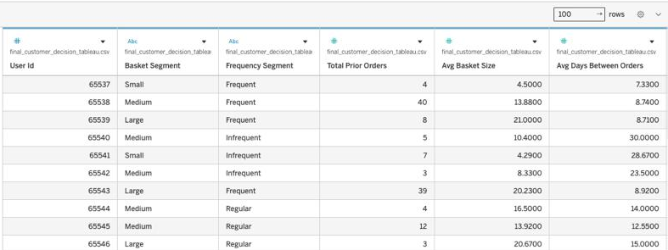
Python validates and prepares the SQL outputs for Tableau, enabling visualization of customer engagement and at-risk segments.
Python / the Tableau-ready extract
Python Validation & Data Preparation
Tableau Visualization & Insights
SQL Results Validated in Python
Interactive dashboard visualizes engagement risk across customer segments
Key metrics independently computed in Python match the SQL reference values
Metric | SQL Value | Python Value | Match
Total Prior Orders | 3,214,874 | 3,214,874
Items per Basket (Average) | 10.09 | 10.09
Days Between Orders (Average) | 10.71 | 10.71
Reorder Rate | 58.97% | 58.97%
Cleaning & Validation
Applied required cleaning logic and ensured a consistent, analysis-ready dataset
Preview of the final Tableau-ready extract, with one row per customer and the key behavioral and segmentation fields used for visualization
Standardized data types and category labels
Handled capped 30-day gaps and insufficient history
Validated customer and segment merges
29,712
At-Risk Customers
119,993
Assessed Customer
24.8%
At-Risk Rate*
Final Output for Tableau
Clean, merged customer-level dataset ready for visualization
Key Tableau Insights
206,209
Customers
13
Columns
0 Duplicate Customer IDs
0 Missing Source Values
Frequent customers show the highest at-risk rates across basket-size segments
Basket size shows limited differences in engagement risk compared with ordering frequency
final_customer_decision_tableau.csv
used as Input for the Tableau dashboard
*Among assessable customers

Slide 8
Targeted, behavior-based rewards can help Instacart address weakening engagement by focusing on customers who are ordering later than expected
Recommendation & next steps
1
2
3
1. Recommended Action
2. Proposed Experiment
3. Next Steps
Launch a personalized reorder reminder with one-click basket rebuilding
Run a controlled experiment to measure the impact of targeted, behavior-based rewards
Move from analysis to implementation and measure results
  Target customers showing weakening engagement based on their deviation from expected ordering behavior
Treatment Group
Behavior-based rewards(by engagement status)
Control Group
No intervention (existing experience)
1
Identify
Use the final customer dataset to select eligible Weakening and High Concern customers
vs
  Use targeted, time-limited rewards to encourage a repeat purchase
Compare key outcomes between treatment and control groups
2
Test
Run the targeted reward experiment against a control group
Success Criteria
  Tailor rewards by engagement: small rewards for Weakening, win-back offers for High Concern, and milestone rewards for Stable customers
Higher repeat-order rate vs. control group
Shorter time to next order vs. control group
3
Evaluate & Scale
Measure the impact on key outcomes. If successful, refine and scale the initiative
Stable or higher average basket size vs. control group
29,712 customers
identified as Weakening or High Concern

Slide 9
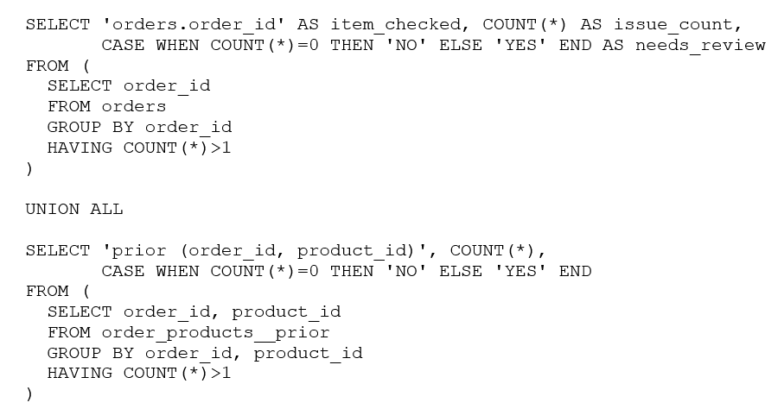
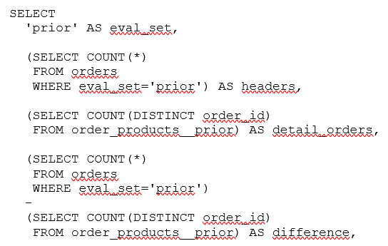
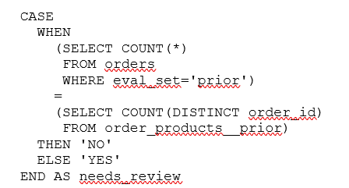
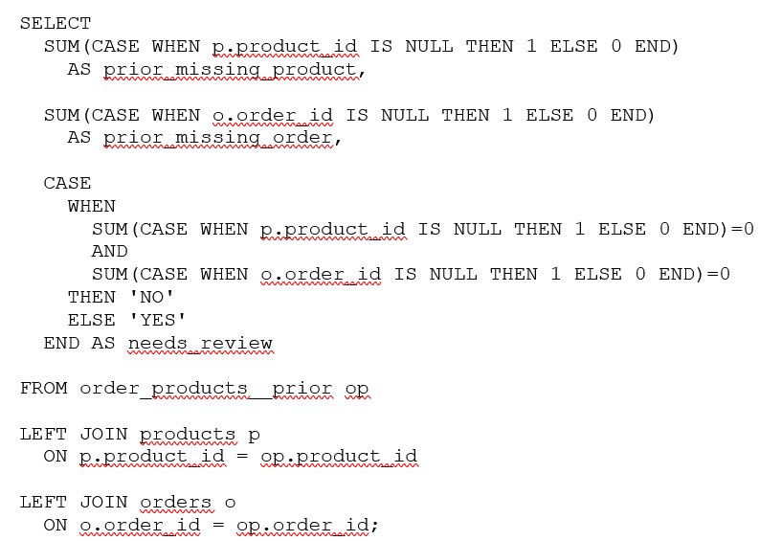
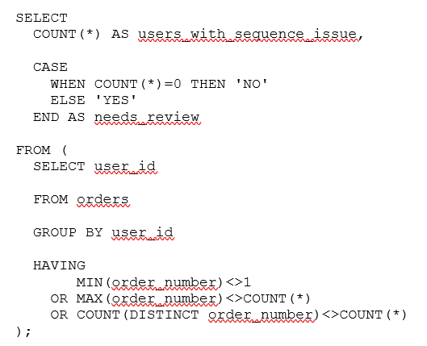
Appendix A1 - SQL Data Quality Checks
Appendix
1. Duplicate Business Keys
3. Prior / Train Reconciliation
2. Orphaned Foreign Keys
4. Order Sequence Integrity

Slide 10
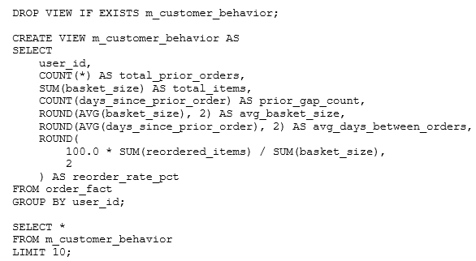
Appendix A2 - SQL Customer KPI Layer
Appendix
Customer KPI Construction

Slide 11
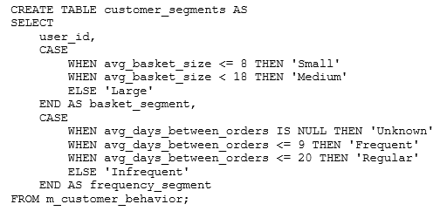
Appendix A3 - SQL Customer Segmentation Logic
Appendix
Segmentation Logic

Slide 12
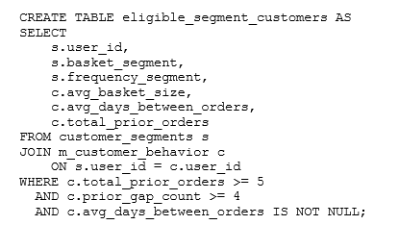
Appendix A4 - SQL Engagement Classification
Appendix
1. Expected Order Gap by Segment

Slide 13
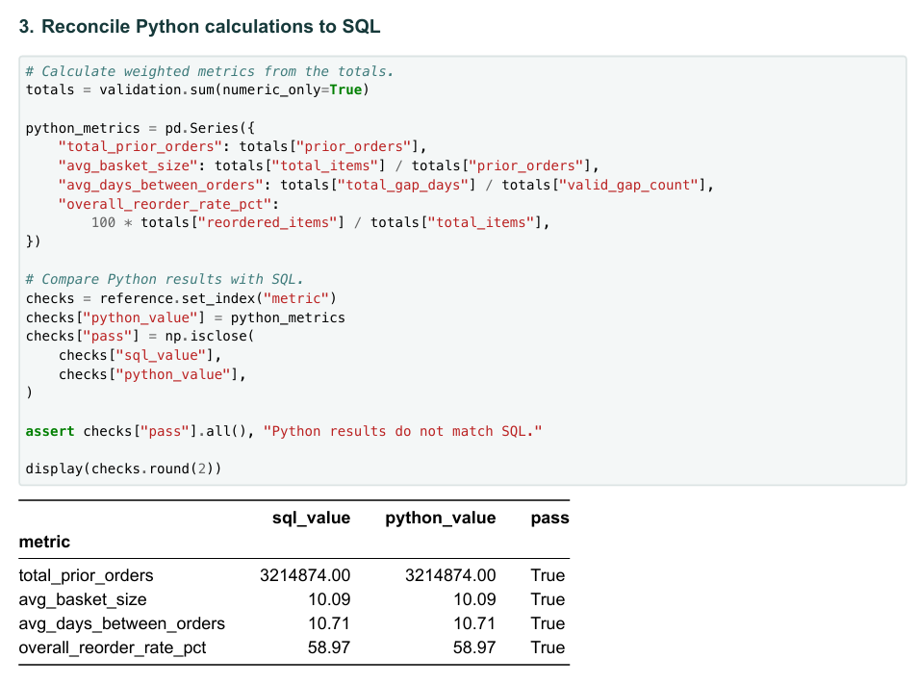
Appendix A5 — Python Validation of SQL Results
Appendix

Slide 14
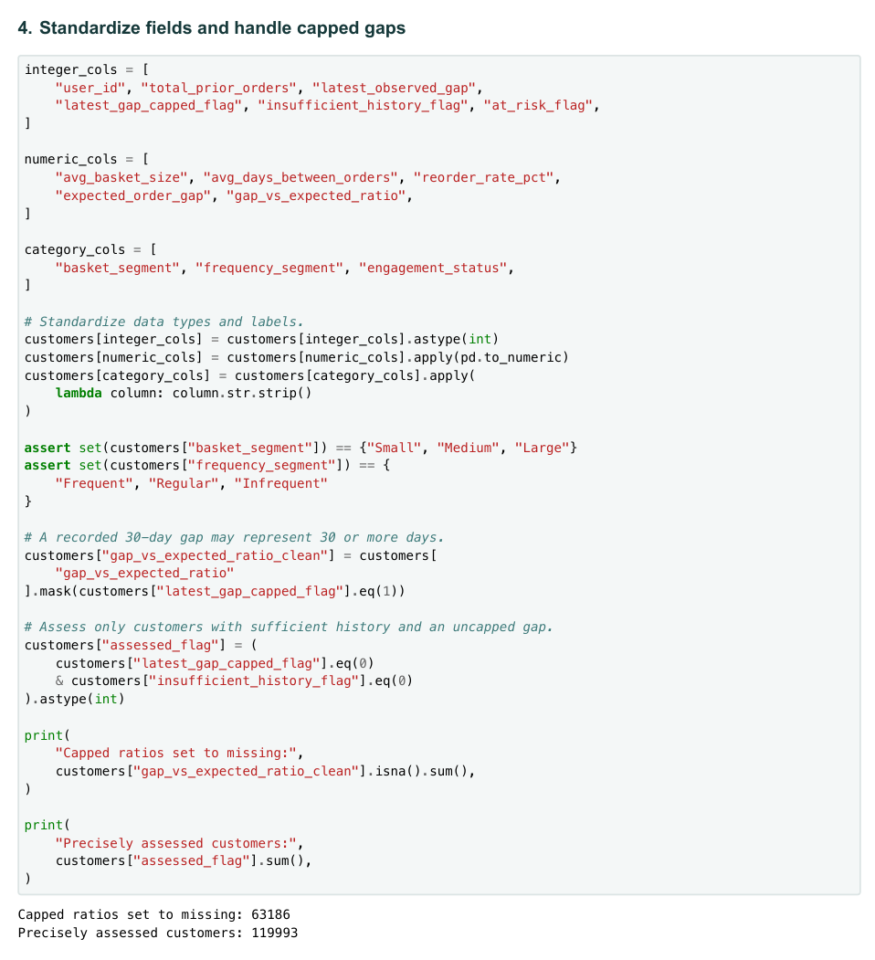
Appendix A6 — Python Cleaning & Validation
Appendix

Slide 15
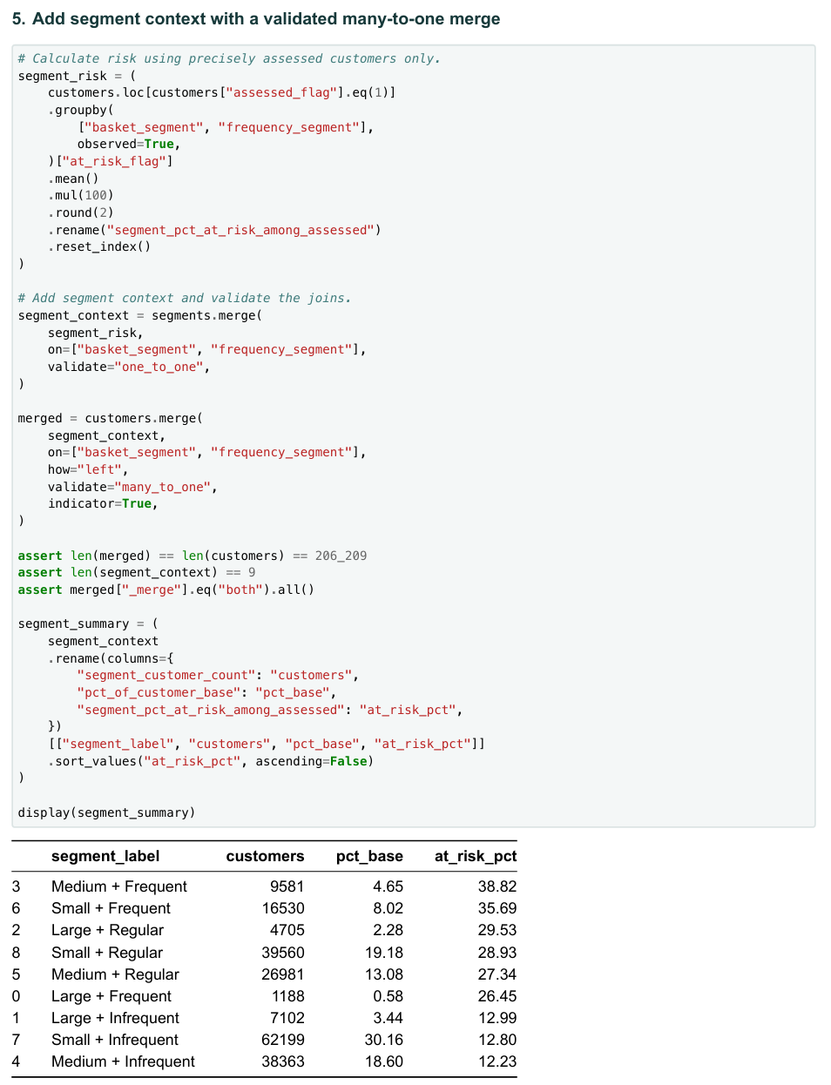
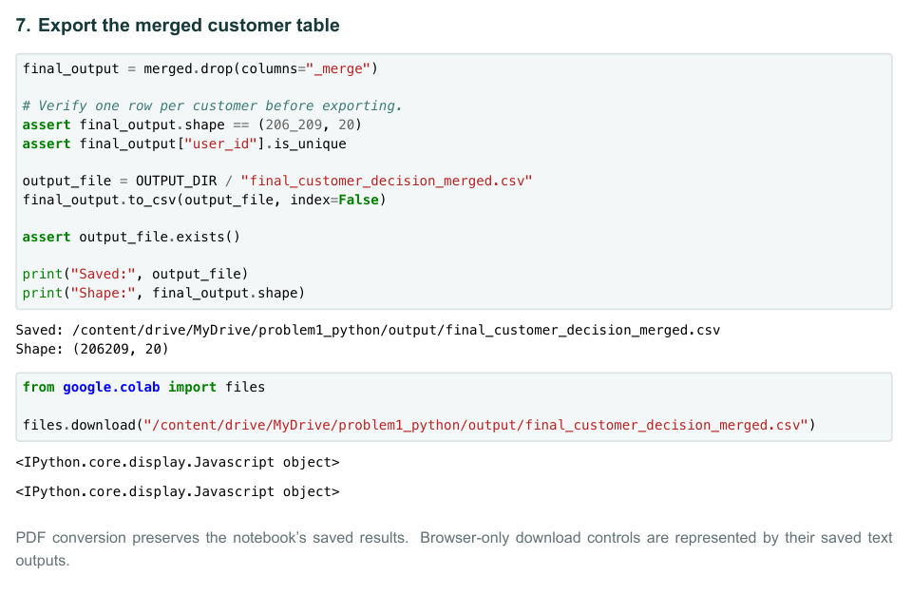
Appendix A7 — Python Final Merge & Export
Appendix

Slide 16
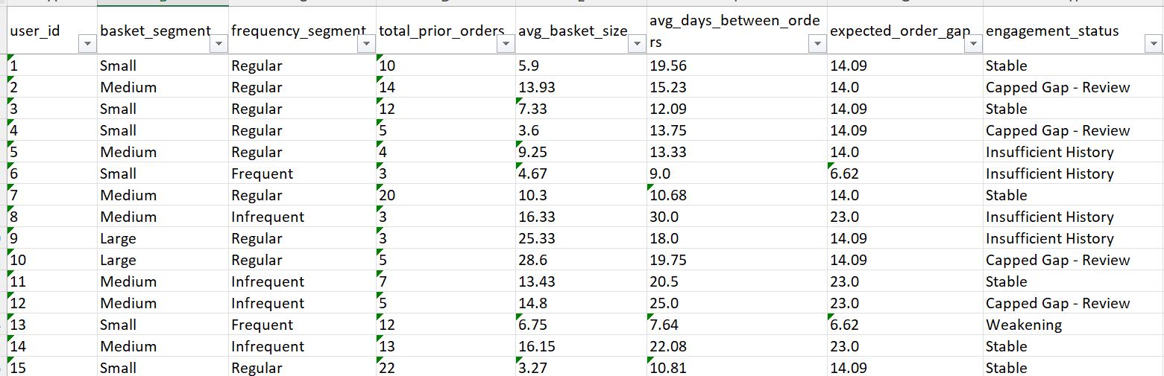
A8 — Tableau Data Source & Structure
Appendix
Final Tableau-ready extract with one row per customer, combining behavioral metrics, customer segments, expected ordering behavior, and engagement status

Slide 17
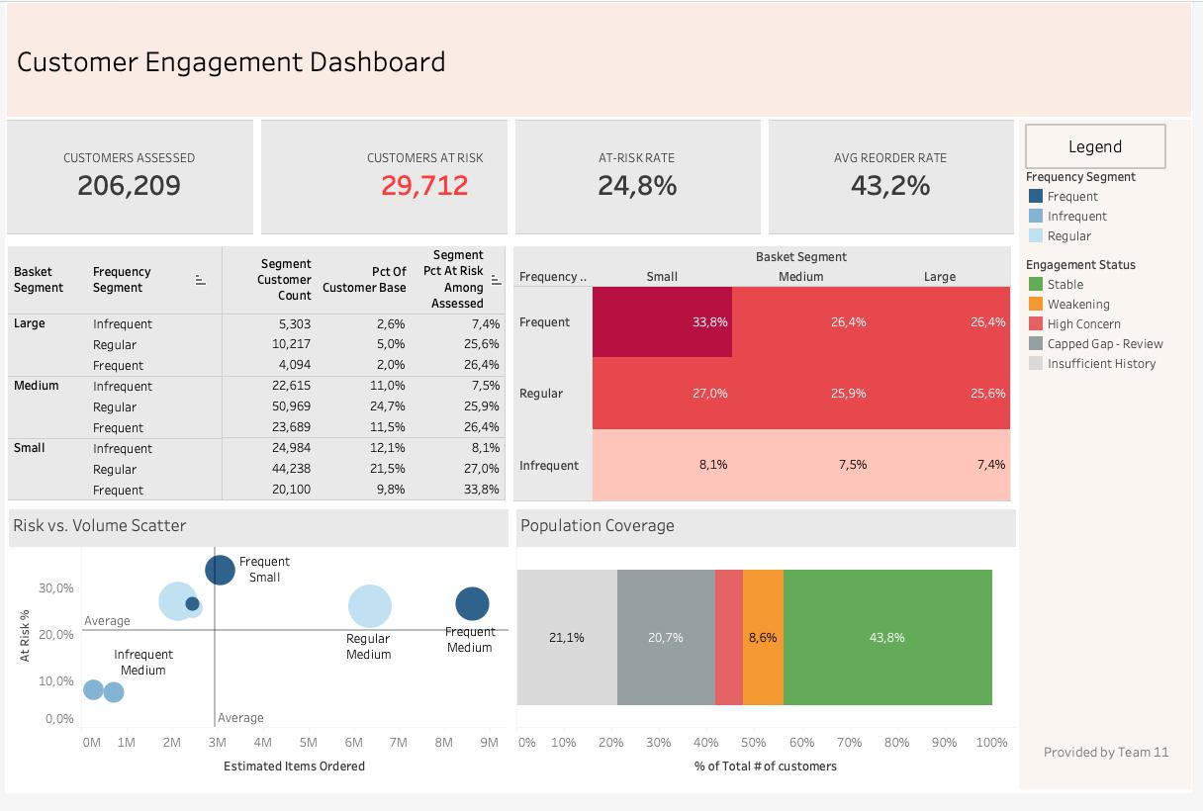
A9 — Tableau Dashboard & Visualizations
Appendix
The Tableau dashboard visualizes customer engagement risk across behavioral segments and highlights where engagement is weakening

